Slide 1
Simplifying Windows runtime and deployment in K8s
Muzz Imam & Michael Michael

Slide 2


Who Are We?
Muzz Imam
SIG-Windows Contributor
Senior Program Manager, Microsoft
@Muzz Imam on K8s Slack
Michael Michael
SIG-Windows Co-Chair
Director of PM, VMware
@m2 on K8s Slack

Slide 3
Agenda
Where we are today
Continuous Improvement
containerd Update
Networking Enhancements
Future Roadmap

Slide 4
History
1.5 - Alpha Release - Kubelet and kube-proxy running on windows. Show the art of the possible despite limitations
1.9 - Beta Release - Tremendous updates in functionality and CNI support
1.14 - Stable Release - Support for adding Windows Server 2019 nodes to Kubernetes
1.15, 1.16, 1.17 - Kubeadm, CSI, runAsUsername, kubectl port-forward, AWS EBS support, Windows Server 1903 support
1.18 – GMSA and runAsUserName to stable, kubeadm to beta, cluster API alpha, CSI Proxy alpha, containerd alpha
1.19 – CSI Proxy to beta, containerd to beta, DSR, Endpoint slices, stability & performance

Slide 5
containerd
Today’s benefits:
Align with direction of K8s community and active investments
Optimized and maintained by the Community
Enables usage of new CNI plugins (sdnoverlay, nat, sdnbridge)
Robust Architecture (less monolithic than docker, Shim process separate from the runtime)
New features (Single-File Mapping, Graceful Shutdown, Improved workflow for CNI, True Namespaces)
HCS v2 schema
Future benefits:
Hyper-V isolation
GMSA support
Notes:
1. Optimized and maintained by Windows OS team? 2. Enables usage of new CNI plugins https://github.com/microsoft/windows-container-networking that use optimized v2 workflow for workload container attachment and adherence to CNI spec criteria “A runtime must not call ADD twice” https://github.com/containernetworking/cni/blob/master/SPEC.md#general-considerations

Slide 6
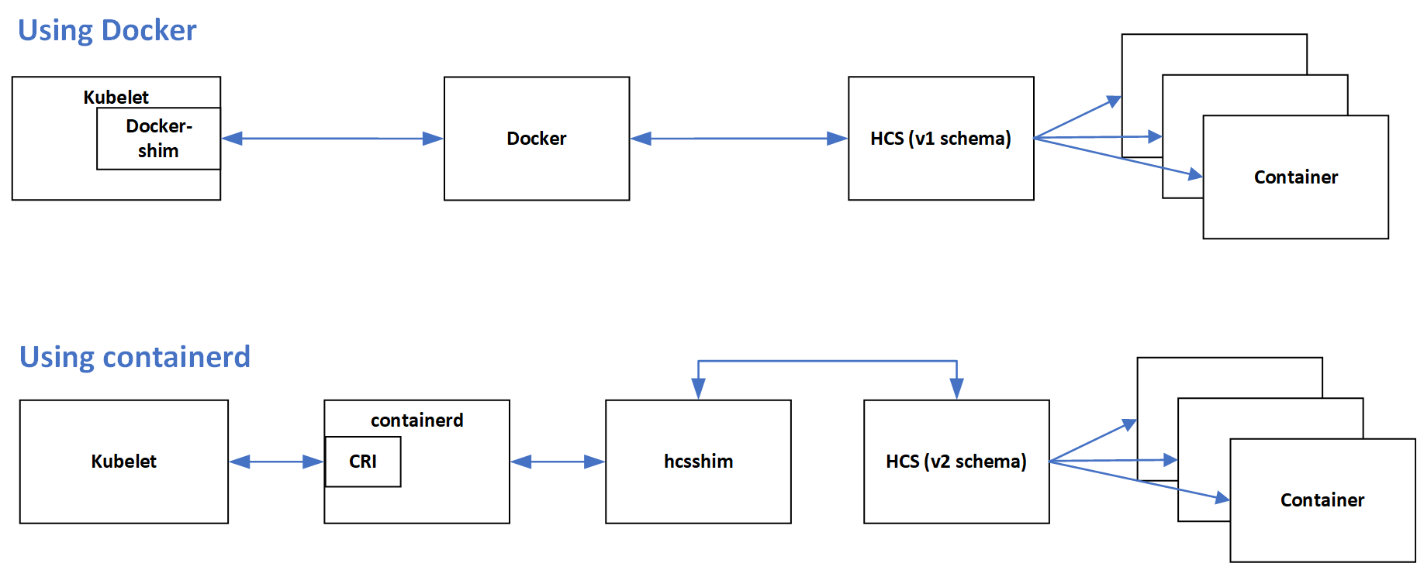
Runtime Architecture
Notes:
Lib container

Slide 7
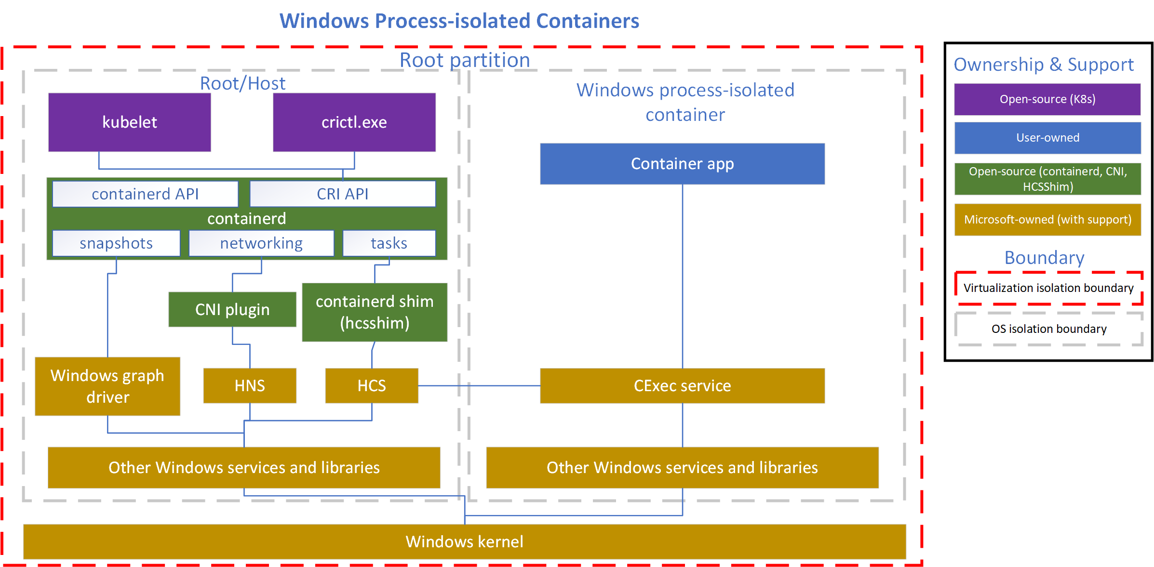
containerd Architecture
Notes:
Graph driver = snapshot

Slide 8
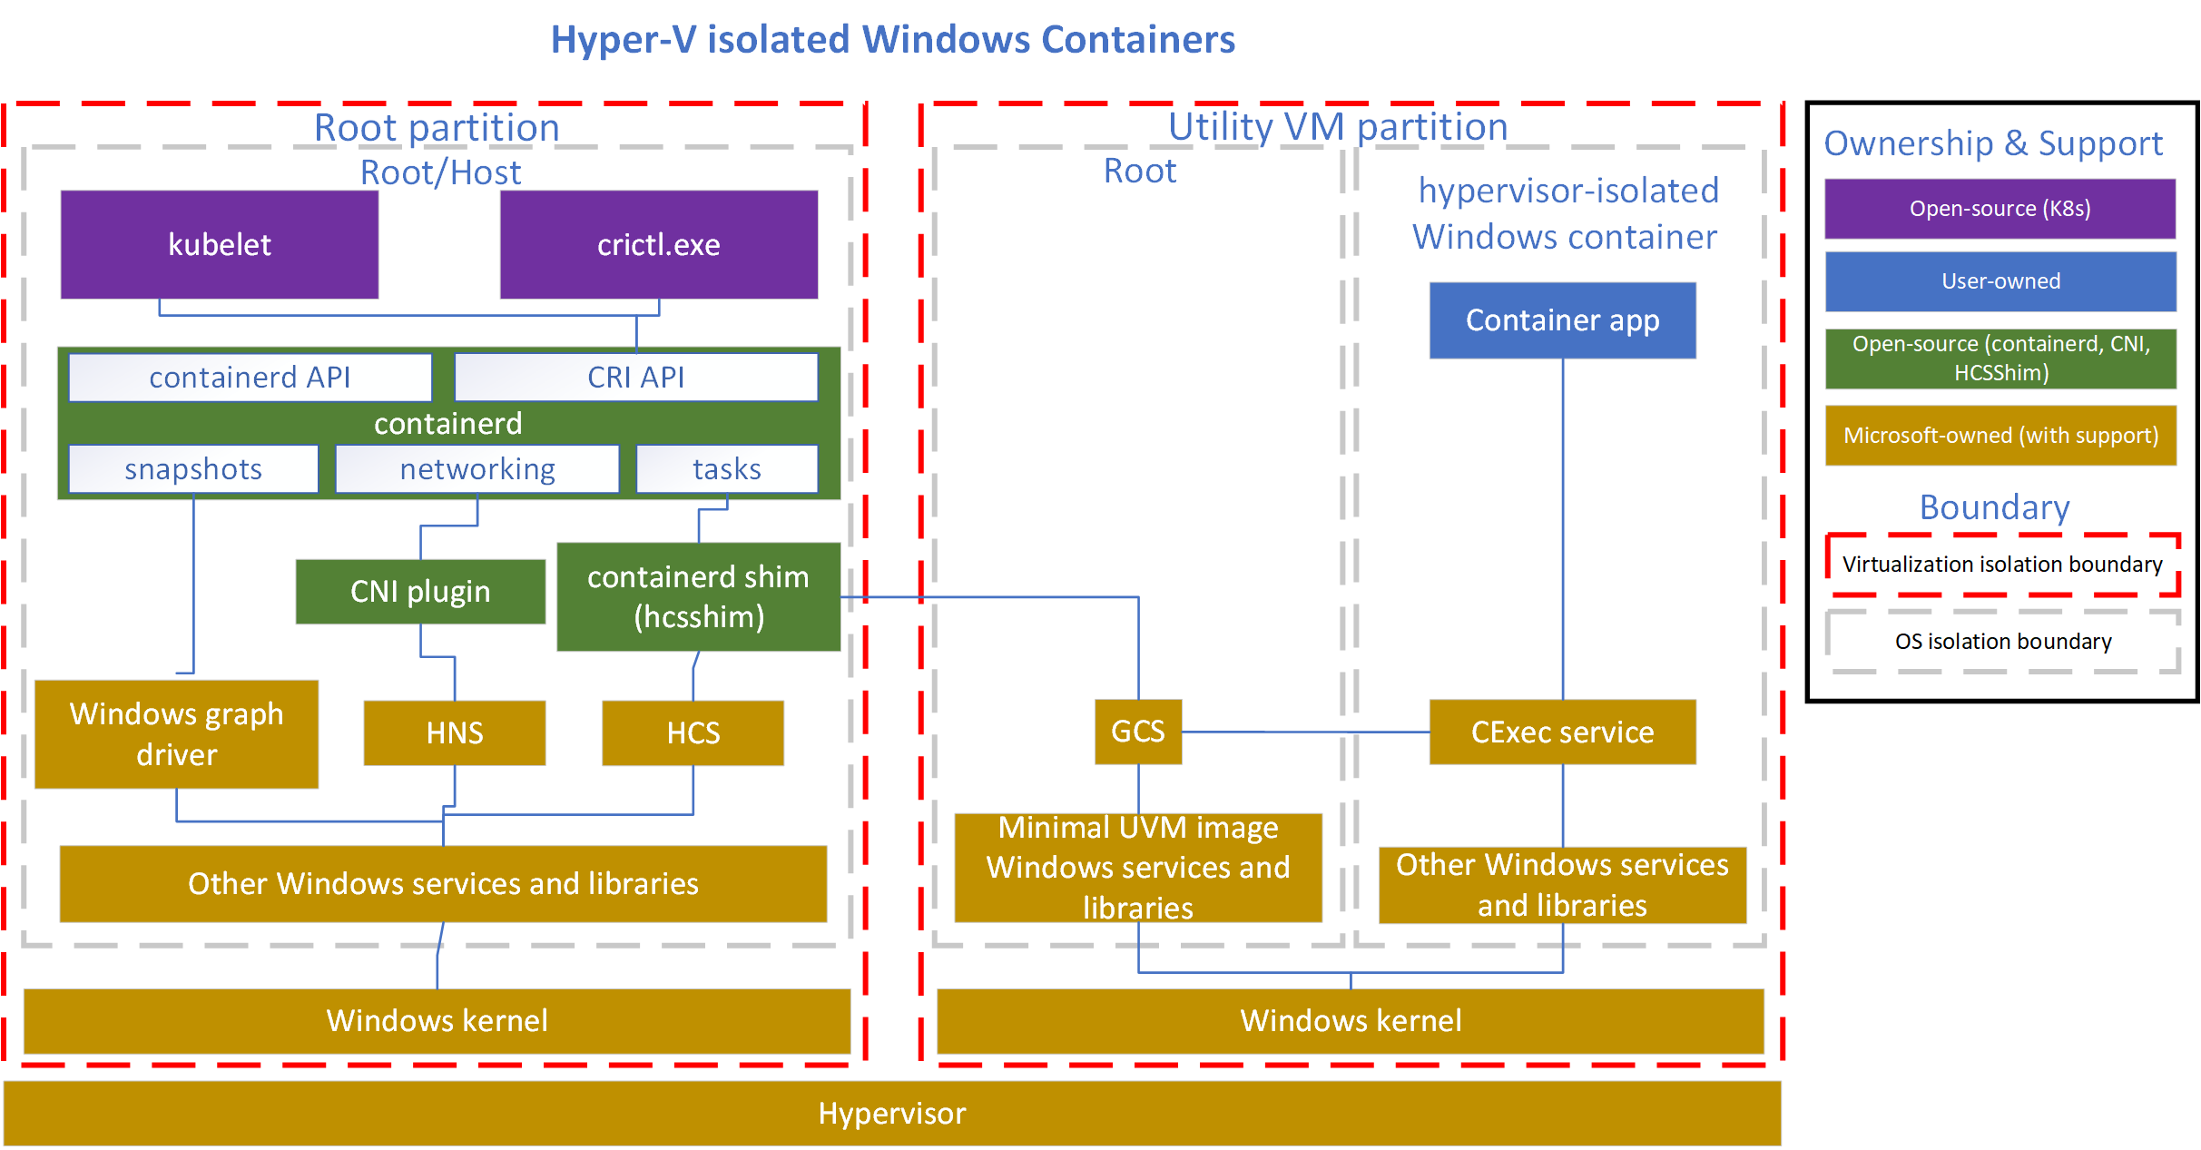
containerd (Hyper-V) Architecture

Slide 9
Technology Matrix
Windows Release | Release Type | Kubernetes
Windows Server 2019 | LTSC | v1.14+
Windows Server version 1903 | SAC | v1.17-v1.18
Windows Server version 1909 | SAC | v1.18+
Windows Server version 2004 | SAC | v1.19
containerd Support Level | Kubernetes | containerd | Windows Release
Alpha | v1.18 | v1.4 | Windows Server 2019
Beta (without hyper-V) | v1.19 | v1.4 | Windows Server 2019
GA (with Hyper-V) - Tentative | v1.20 | v1.5 | Windows Server 2019 Windows Server version 1909 Windows Server version 2004
For more information, visit the Windows Server servicing info page

Slide 10
Networking Enhancements
Dual-stack IPv6 support
Improvements to Kubernetes Services
Endpoint slices
Supports Services with large # of endpoints efficiently
Kube-proxy direct server return (DSR) mode
Supports scaling to large # of Services efficiently
Session affinity
Associate traffic from a unique client to a single backend pod (“sticky sessions”)
Destination IP preservation
Preservation of destination IP for DSR mode network traffic
LocalRoutedVIP feature
Supports local NodePort access from host/local pods
Antrea CNI shipped v0.8.0 with full Windows support, including network policies
Future (v1.20+)
Support for client IP preservation using externalTrafficPolicy=“local”
IPv6 support in CNI plugins (currently only Azure CNI plugin supports IPv6)
Notes:
Notes with PRs
---
Dual-stack IPv6 support (#90853)
Improvements to Kubernetes Services
Endpoint slices (#90909)
Supports Services with large # of endpoints efficiently
Kube-proxy direct server return (DSR) mode (#93080)
Supports scaling to large # of Services efficiently
Session affinity(#91701)
Associate traffic from a unique client to a single backend pod (“sticky sessions”)
Destination IP preservation (#74825)
Preservation of destination IP for DSR mode network traffic
LocalRoutedVIP feature (#74825)
Supports local NodePort access from host/local pods
Future (v1.20+)
Support for client IP preservation using externalTrafficPolicy=“local” (#93166)
IPv6 support in CNI plugins (currently only Azure CNI plugin supports IPv6)

Slide 11
Roadmap
Compute
Keep investing in CRI-ContainerD
Hyper-V isolation support
GPU Support
Deployment & LCM
Promote kubeadm to stable
Cluster API support for Windows worker nodes
Storage & BCDR
Promote CSI work to stable
Add more storage providers to CSI proxy
Light up Velero support with CSI snapshots
Deprecate in-tree storage plugins for Windows

Slide 12
How you can contribute
Join our weekly meetings at 12.30pm Eastern every Tuesday
View the recorded community meetings
Help us write additional documentation and user stories
Find bugs you can fix in our project board (start with “good first issue”)
Review open PRs

Slide 13





Windows Community
Michael Michael
Co-Chair
Director of PM, VMware
@m2 [Slack]
@michmike [GitHub]
Mark Rossetti
Co-Chair
Principal PM, Microsoft
@Mark Rossetti [Slack]
@marosset [GitHub]
Deep Debroy
Technical Lead
Engineering Manager, Docker
@ddebroy [Slack, GitHub]
Slack.k8s.io
#sig-windows
https://groups.google.com/forum/#!forum/kubernetes-sig-windows
https://kubernetes.io/docs/setup/production-environment/windows/
https://github.com/kubernetes/community/tree/master/sig-windows
YouTube Playlist
https://zoom.us/j/297282383
Every Tuesday @ 12.30pm EST

